Slide 1
IOT FOR HEALTHCARE MINI PROJECT
PRESENTED BY UNDER THE MENTORSHIP OF
NAME :-VEDANT NEGI Prof. (Dr.) Sachin Sharma
UNIVERSITY ROLL NO. :- 2019225

Slide 2
ECG DISPLAY USING PULSE SENSOR WITH OLED & ARDUINO
With tons of new healthcare technology start-ups, Arduino along with IoT and Embedded System is rapidly revolutionizing the healthcare industry. In this project we will learn how to design the ECG Display using Pulse Sensor with OLED & Arduino. We will use 0.96’’ OLED Display with 128x64 resolution for BPM & ECG waveform display. The 12C OLED uses only 2 wires , i.e. SDA & SCK for serial communication.
The Arduino sketch running over the device implements the various functionalities of the project. These functions are reading sensor data, converting them into strings, passing them to 12C communication and displaying measured pulse rate in 12C OLED Display.

Slide 3
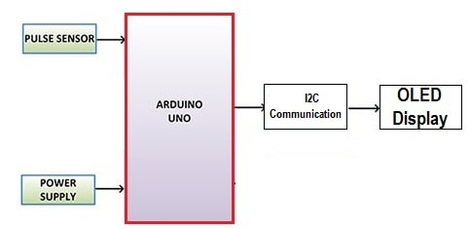
BLOCK DIAGRAM

Slide 4
BLOCK DIAGRAM
We need two different power supply each for OLED & Pulse Sensor. We can get these supplies from Arduino UNO Board as it has 3.3V & 5V output voltage. OLED can be connected to 3.3V & Pulse Sensor can be connected to 5V.
Similarly, Arduino acts as a processor and converts the code into predefined output. The OLED Display works on the principle of 12C Communication. It requires only two wires for displaying the defined output.

Slide 5
COMPONENTS REQUIRED
COMPONENT REQUIRED QUANTITY
Arduino Nano Board 1
Pulse Sensor 1
0.96’’ 12C OLED Display 1
Buzzer 5V 1
Connecting wires 10
Breadboard 1

Slide 6
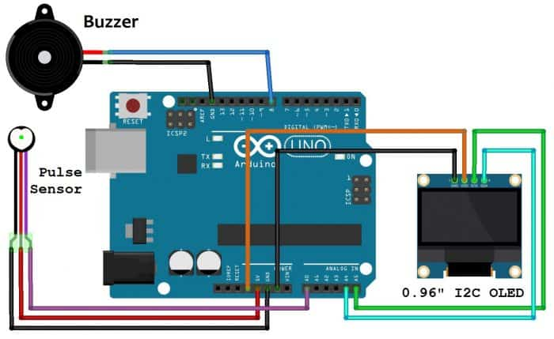
CIRCUIT DIAGRAM & CONNECTIONS

Slide 7
CIRCUIT DIAGRAM & CONNECTIONS
Connect pulse sensor VCC pin to Arduino 5V Pin and GND to Ground. Connects its signal pin to Arduino Analog pin A0.
Similarly connect the VCC Pin of OLED Display to Arduino 3.3V pin and GND to Ground. Connect its SDA & SCK pins to Arduino A4 & A5 pins respectively.
Connect a buzzer to Arduino digital pin 8 and another pin to GND.

Slide 8
Working & setup
PULSE SENSOR :-
The pulse sensor works by emitting an Infra-Red signal from an IR-Diode onto the
skin. Just underneath the skin, there are capillaries carrying blood. Every time heart
pumps there is a small increase in blood flow/pressure. This swells the capaillaries slight,
this slightly more filled capaillary reflects more infra-red than at times when the heart is
not giving your blood a “push”. An Infra-detector on the device senses the different
reflected IR levels. Some simple comparator circuitry converts this into a voltage signal
which we can read with the Arduino Analog inputs

Slide 9
WORKING & SETUP
OLED 128x64 (SSD1306 Driver) Display :-
In this project, we are adding an ECG waveform plotter along with BPM on the
OLEd display. For this we need 2 different library, i.e. SSD1306 Driver & GFX Library.
Firstly ensure you have bought an OLED 128x64 IC display {SSD1306 driver) display. It
should have four connections, i.e. 5V, GND, SDA, SCK.

Slide 10
WORKING & SETUP
OLED Address :-
Since the OLED used here is an 12C OLED, so it has a particular device address.
To find the 12C address first scan the OLED Display has a device address of 0x3C or
0x3D.

Slide 11
Working & setup
FINAL DISPLAYED OUTPUT :-
After code is uploaded to Arduino Board, at first no graph or waveform is seen.
But when the finger is placed the BPM value is displayed as well as the graph is drawn
along with the beep sound from the buzzer. The value may be irregular or unstable at
starting for few seconds but later the value becomes stable. The sensor is not too
accurate as it is cheap. So do not use this for medical purpose.

Slide 12
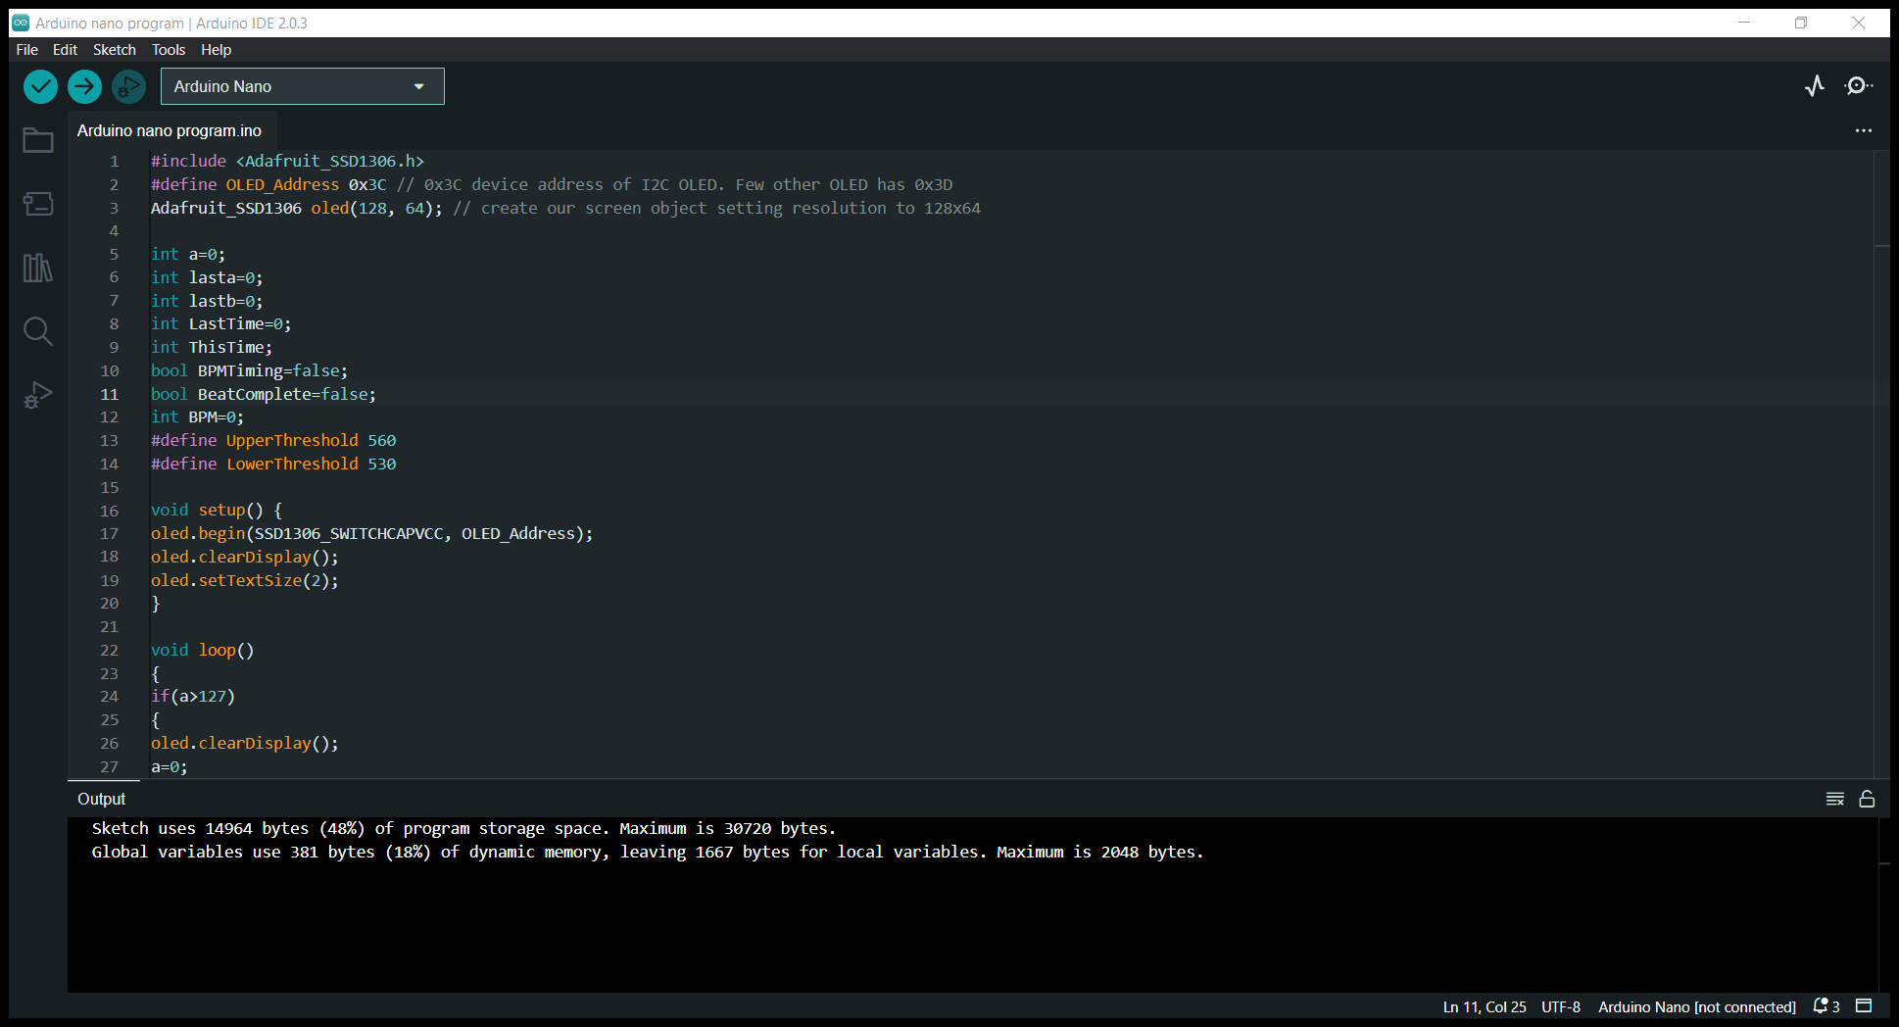
SOURCE CODE & PROGRAM

Slide 13
RESULT
The project was able to measure the ECG using the pulse sensor with OLED and Arduino. The Arduino sketch running over the device implements the various functionalities of the project. These functions are reading sensor data, converting them into strings, passing them into 12C communication and displaying measured pulse rate in 12C OLED Display.

Slide 14
CONCLUSION
IoT can automate the workflow of patient care by using healthcare mobility solutions. Data movement, machine-to-machine communication and interoperability have made healthcare sectors more productive. With the integration of IoT, patients and healthcare professionals can save time.
In next few years, we can expect the usage of internet of things devices to reach 7 billion. In 2022, the number of IoT devices will surpass laptops and smartphones. Internet of Things devices will number over 21 billion by 2025. IoT trends will continue to grow as a major force in the industry.

Slide 15
REFERENCE
www.google.com
www.github.com
www.researchgate.com

